Slide 1
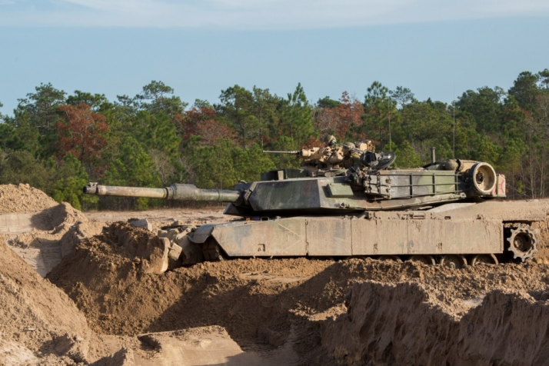
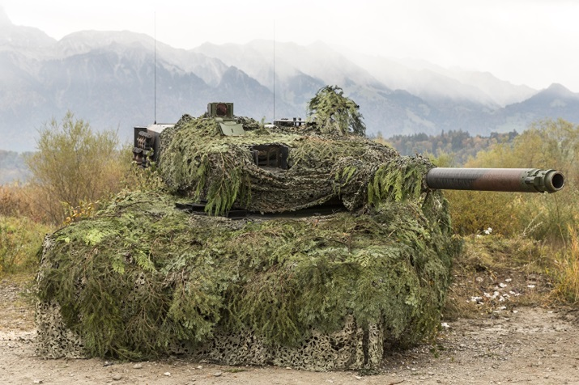
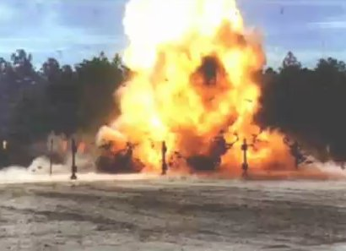
MILITARY ENGINEERING
SECURITY AND DEFENCE PROGRAMM
Survivability Tasks and Fundamentals

Slide 2
BASIC LITERATURE
STANAG 2528 ALLIED JOINT DOCTRINE FOR FORCE PROTECTION - AJP-3.14 (April 2015);
STANAG 2394 ALLIED TACTICAL DOCTRINE FOR MILITARY ENGINEERING – ATP-3.12.1 (February 2016);
STANAG 3680 NATO GLOSSARY OF TERMS AND DEFINITIONS (ENGLISH AND FRENCH) - AAP-6 (2012);
STANAG 2991 NATO COMBAT ENGINEER GLOSSARY – AAP-19(D); (August 2004);
AAP-15 NATO GLOSSARY OF ABBREVIATIONS USED IN NATO DOCUMENTS AND PUBLICATIONS (2010).

Slide 3
THE LESSON CONTENT PLAN
Explanation of survivability principles and philosophy;
Characteristics of survivability tasks
Questions answering (if any);
Notice:
You may have questions any time during the lesson.

Slide 4
THE CONCEPT OF SURVIVABILITY
All arms/branches are responsible for their own immediate survivability requirements. Engineers will augment and enhance unit survivability measures within the limits of available resources and the priorities of the commander. Engineer effort will be concentrated on tasks requiring specialist skills or equipment. Survivability measures begin with the use of all available concealment and cover, followed by digging and constructing fighting and protection positions.
During military operations other than war or combat, the design, resourcing and construction of appropriate force protection facilities including camps and other facilities, will usually become an engineer responsibility. This key task will demand a range of specialist skills and equipment to protect the force and enable it to conduct operations effectively in a cross-spectrum environment.

Slide 5
SURVIVABILITY MAIN TASKS
Assistance in the preparation and construction of field fortifications.
Assistance in the hardening and construction of protective infrastructure works. This includes collective protection against the CBRN threat.
Assistance with camouflage, concealment and deception.
Assistance in the clearance of fields of fire.
Explosive threat Management.

Slide 6
SURVIVABILITY IN OFFENSIVE OPERATIONS
During offensive operations, use of multiple routes, dispersion, highly mobile forces and wise use of terrain are the best ways to ensure survivability. Planned measures must not unduly restrict the force’s ability to manoeuvre at will. This will allow the commander to achieve concentration, speed and flexibility. The following engineer measures may be used:
Field fortifications
Camouflage
Deception

Slide 7
SURVIVABILITY IN OFFENSIVE OPERATIONS fortifications
Engineers may construct fighting positions for tactical vehicles and weapon systems. Although not as extensive as in the defense, protective emplacements for artillery, air defense units and logistic concentrations are normally considered in the plan. Commanders may require hardening of key command and control facilities, especially those with a detectable electronic signature. Engineer assistance during offensive operations also may be required to provide field fortifications for:
Reserves waiting in hide areas.
Assault forces consolidating on an objective.
Manoeuvre forces which are required to halt during the advance.
Supplementary and alternate positions.

Slide 8
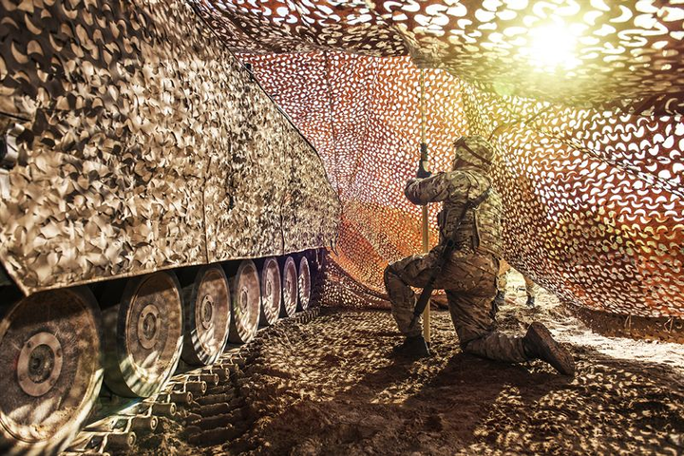
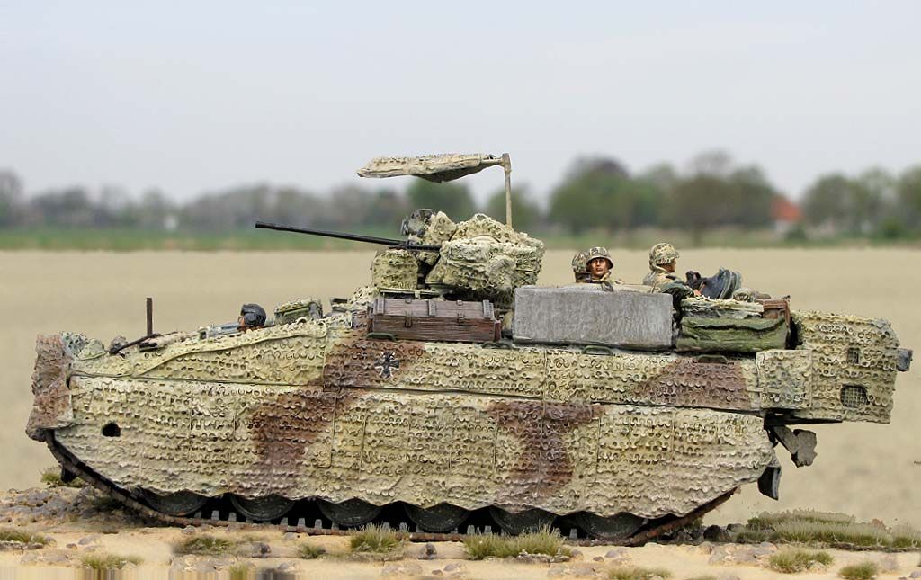
SURVIVABILITY IN OFFENSIVE OPERATIONS CAMOUFLAGE
In a fast-moving offensive situation, time may not allow extensive camouflage measures to be taken. Engineers advise on site selection and proper use of terrain to provide the most expedient camouflage.

Slide 9
SURVIVABILITY IN DEFENSIVE OPERATIONS
Survivability includes all aspects of protecting personnel, weapons and supplies by employing:
Sound tactics
Dispersion and frequent unit moves.
Camouflage and concealment.
Deception.
Emission security.
Engineer Support to Force Protection

Slide 10
SURVIVABILITY IN DEFENSIVE OPERATIONS
Major engineer survivability tasks will include assistance to other arms/branches in:
Field Fortifications.
Protection of combat supplies.
Camouflage, concealment and deception.
Camp and facility construction where appropriate

Slide 11
SURVIVABILITY IN DEFENSIVE OPERATIONS FORTIFICATIONS
The preparation of field fortifications is an all arms/branches responsibility and is a sub-set of the broader issue of Force Protection Engineering (FPE). When time is short or the nature of the terrain requires special techniques, such as the use of earthmoving equipment or explosives, engineers may provide support in accordance with the commander’s priorities. Possible engineer tasks include:
Advice on the construction of field fortifications.
Construction of command posts.
Construction of artillery gun positions, tank scrapes and weapon pits.
Preparation of alternate positions.
Preparation of sites for tactical air and aviation units.
Construction of storage facilities for ammunition and other materiel.
Advice on, and on occasions, assistance with, the construction of protective barriers.
Strengthening field fortifications.

Slide 12
SURVIVABILITY IN DEFENSIVE OPERATIONS Protection of Combat Supplies
Combat supplies should be protected in particular against blast, shrapnel, incendiaries and CBRN contamination. It is most important to provide protection for ammunition and fuel stores. The types of shelter built will depend upon the terrain and soil type as well as on the availability of existing buildings and natural cover. By giving advice to the logistic commander on the selection of the most suitable storage sites, the requirements for engineer support may be considerably reduced.

Slide 13
SURVIVABILITY IN DEFENSIVE OPERATIONS CAMOUFLAGE AND CONCEALMENT
In general, all units are responsible for their own concealment and local camouflage. Major positions, facilities, and operational sites, may, however, require special camouflage stores and measures. The tactical commander may then require engineers to undertake such tasks, as advised by his engineer commander. Efforts must be made to mitigate the distinctive signatures that engineer work in preparing battle positions can create. Apart from the use of camouflage nets and natural camouflage material, special camouflage measures often require the employment of engineer equipment and devices. This is especially true for large-scale camouflage requirements.

Slide 14
ANY QUESTIONS?

