Slide 1
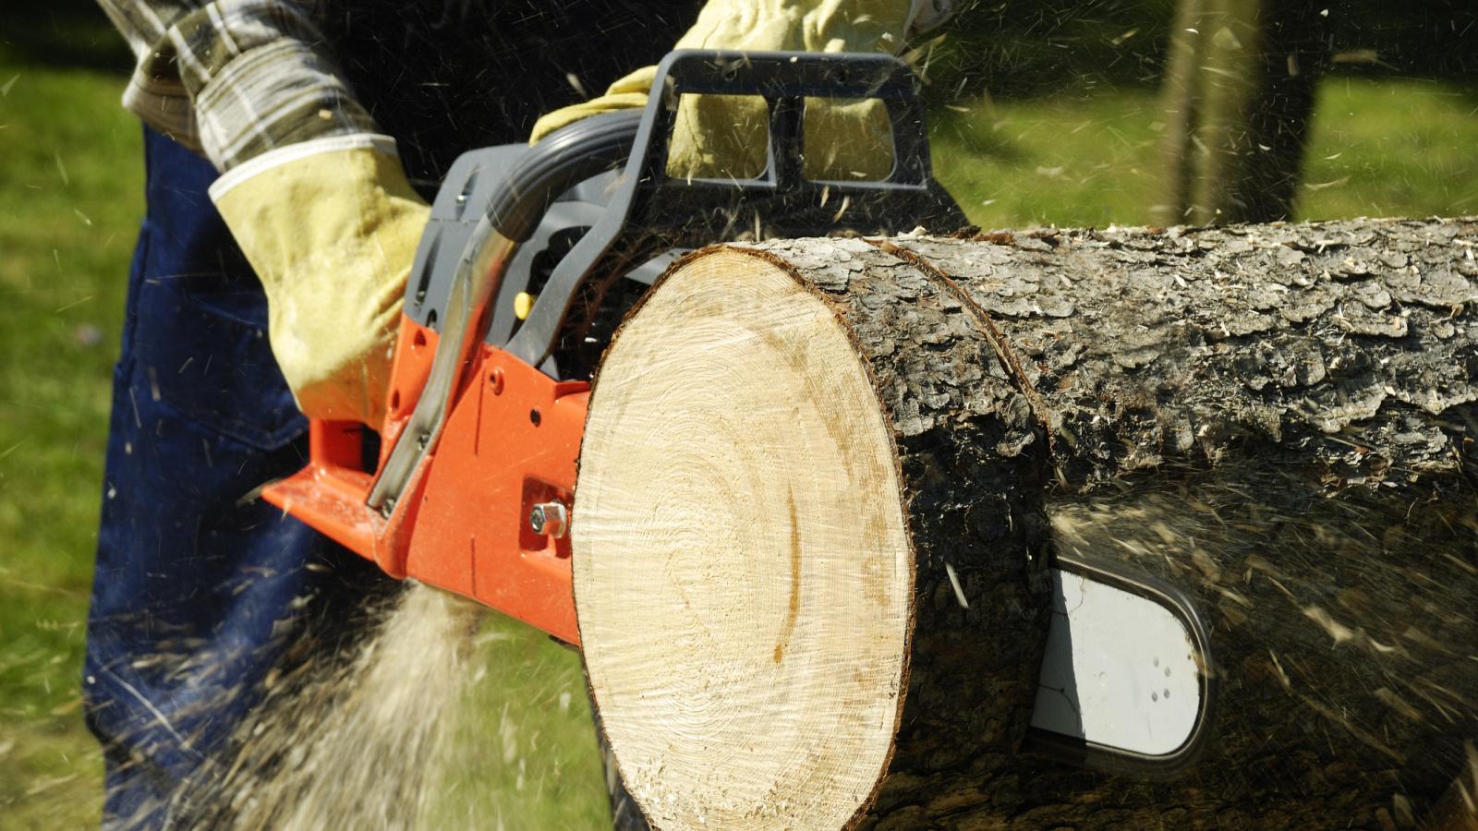
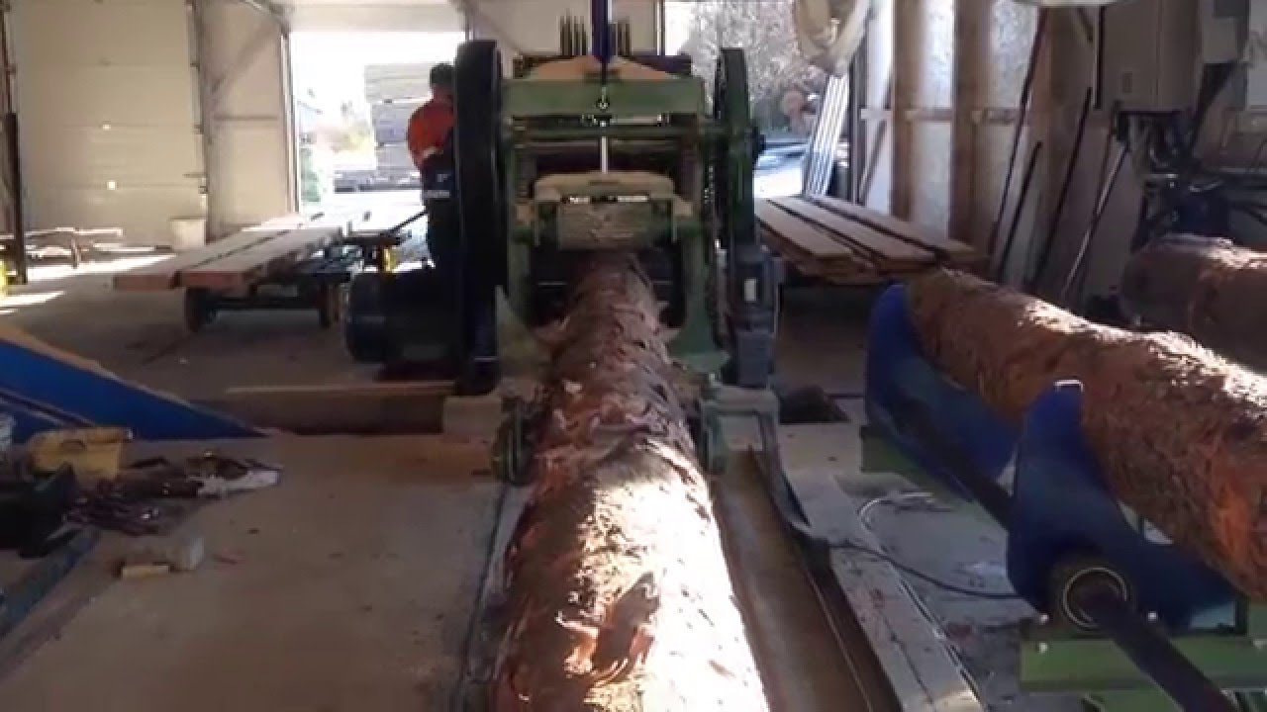
MILITARY ENGINEERING
SECURITY AND DEFENCE PROGRAMM
Wood cut and fabrication equipment

Slide 2
THE LESSON CONTENT PLAN
Explanation of wood working theory;
Characteristics of woodworking machinery
Questions answering (if any);
Notice:
You may have questions any time during the lesson.

Slide 3
Machinery for lifting and woodworking
Wood has always been important for human society raw material with many uses. Served for the construction of dwellings, housing production equipment, tools and apparatus and was an important source of thermal energy.
Large expansion timber found in military conditions in the past and at present primarily for their useful physical and mechanical properties such as e.g. a relatively low density, bending strength and compressive strength, good process ability and a relatively long shelf life.
For the army is also important easy availability of wood as a raw material, mainly for the construction of bridges for shallow water, strengthening of existing bridges, construction of various buildings fortification, reinforcing roads and other engineering work.

Slide 4
Machinery for lifting and woodworking
The wood is used in the performance of a wide range of tasks within the movement's own security forces, restrictions on the activities of the enemy, preserve combat capability and within the general engineer support.
In this section we discuss the properties of wood, ways of cutting wood, sawmills, timber plants.
Properties of wood
Wood is a material of organic origin produced perennial woody plants during the growth of strains in length and thickness. After morphological page consists of the cells, respectively. from their walls.
Since the cell timber consisting mostly elongated, oriented in parallel with the axis of the trunk or branches and arranged concentrically around it, has wood in different directions or the same structure or the same properties. It is therefore anisotropic material and as such need to be assessed and evaluated.

Slide 5
Machinery for lifting and woodworking
In order to allow the wood raw material is optimally used, it must have a minimum knowledge of its physical, mechanical, chemical and other properties.
The basic physical properties of wood includes:
- Moisture content,
- Density of the wood,
- Porosity of wood,
- Thermal properties,
- Electrical characteristics,
- Acoustic properties.
Mechanical properties of wood express its resistance to external forces. Against them has internal cohesive forces between the molecules of wood (material), called voltage.

Slide 6
Machinery for lifting and woodworking
Wood as a biological material is a complex anatomical and chemical complex.
Consists of cells and intercellular parts of different chemical composition. In addition to water and air wood predominantly contains macromolecular substances carbohydrate (sugar) and lignin nature each other more or less chemically bonded.
Minerals in the wood is less than 1%, determined from the ash content.
Wood is an inhomogeneous material - the composition of the layers of the cell wall, the annual rings (spring and summer wood), individual parts of the trunk and particular species differ from each other. These ingredients are macromolecular character.
Felled trees Branch and branches gave crude tribes in the full length. Subscribers raw timber, however, usually have very specific requirements for tree species, size and quality, or asking quite a particular range of raw timber.

Slide 7
Machinery for lifting and woodworking
Basic categories of characteristics of round wood are species, size and quality.
In most cases, the quality is assessed by the incidence and extent of the defects of timber.
The basic defect of timber, by which we judge the suitability of wood for inclusion in one of round wood is divided in sequential order as to the significance of the following groups:
• knots,
• cracks,
• defects in shape tribe
• defects caused by fungi
• defects in the wood structure,
• insect damage
• damage crypto gamic plants,
• some specific defects.
Minerals in the wood is less than 1%, determined from the ash content.

Slide 8
Machinery for lifting and woodworking
Splitting wood
Work piece material poses during stock removal tool tooth resistance, which is called the cutting resistance. The force which must be applied to the tool to overcome the cutting resistance is called the cutting force.
Specific cutting resistance calculated from the relation
P
K = ------- (MPa)
b . s
where: P is the cutting force (N)
b - width (mm)
s - Followers chip thickness (mm).

Slide 9
Machinery for lifting and woodworking
Cutting force for any chip cross section is calculated from the known values of K according to the relation
P = K . b . s (N).
Cutting force P multiplied by the cutting tool path L gives the size of the cutting work A
A = P. L (J).
Cutting power needed for cutting N per second is calculated as follows:
N = K. O = K. b. h. u (W)
where: b = O. h. u (cm ³. s⁻¹); and
b - width of the chip,
h - cutting height (or depth conclusion)
u - speed (m. s ⁻¹).

Slide 10
Machinery for lifting and woodworking
Saws
These are machines which cut the kerf, the cutting edge of the tool should be a little wider than the thickness of the blade, the teeth must be unfolding or distribution. Cutting process is actually a composite cutting, wherein the removal of sawdust is done by external cutting forces overcoming the strength of wood in compressive and shear.
The tools are called blades, saw blades or saw chains. When the work is done by reciprocating motion (frame saws), linear orbiting (belt and chain saws) or rotary (circular saws and cylinders).
Saw aliased logs on slots, slots process timber into lumber, joists and rafters, produce sections of natural wood and agglomerated materials and machining them to create flat surfaces, grooves or pins.

Slide 11
Machinery for lifting and woodworking
The saw comprises a cutting mechanism, a feed mechanism, a rack and base drives, auxiliary mechanisms and control. Saws are classified by the type of the saw tools:
• Saw-rectilinear reciprocating saw blade, usually cut only in one stroke. These include band saws, scroll saws and saber (fretsaw)
• saw with rotating saw blade, usually cut one branch of the blade.
This includes belt and chain saws,
• rotary (circular) saw with rotating saw blades or rollers.
Lumber Mill
The term timber plants - wood complex includes:
• space for logging,
• store logs,
• storage of logs,
• sawmill - a lumber mill,
• mechanized yard.

Slide 12
ANY QUESTIONS?

