Slide 1
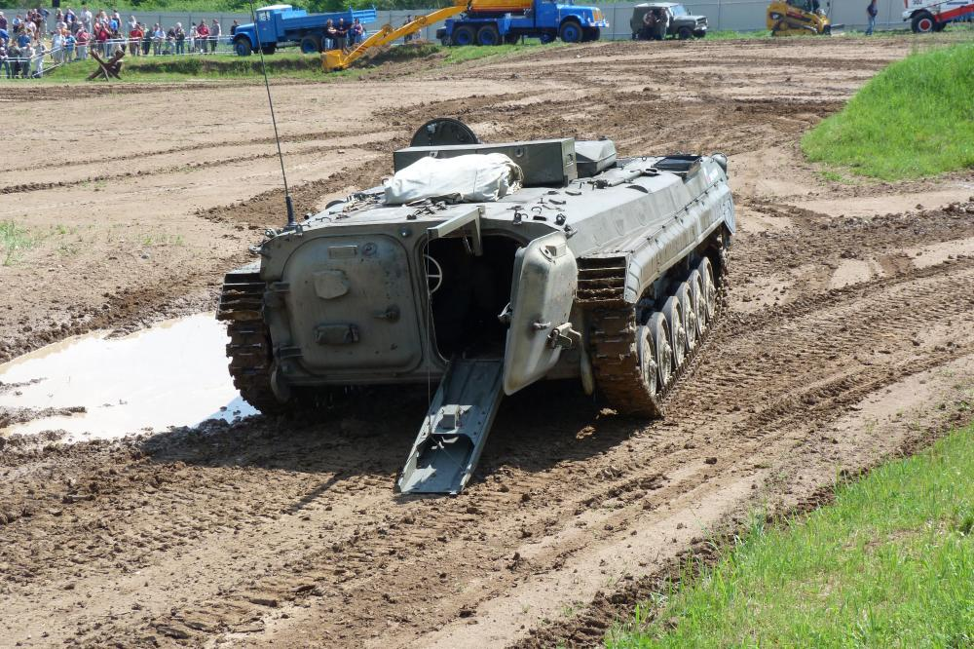
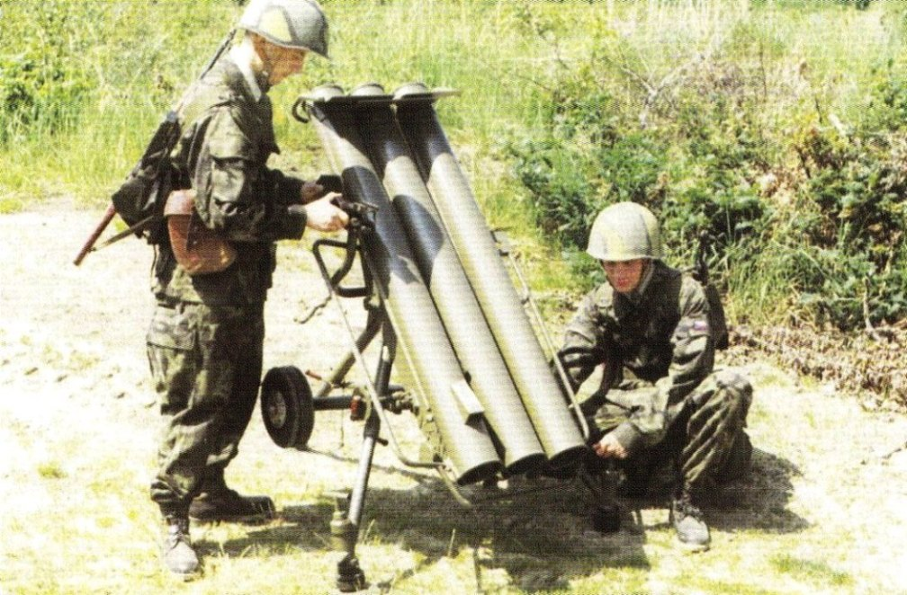
MILITARY ENGINEERING
SECURITY AND DEFENCE PROGRAMM
Obstacle placing equipment

Slide 2
THE LESSON CONTENT PLAN
Explanation of mechanized obstacle laying;
Characteristics of obstacle laying equipment
Questions answering (if any);
Notice:
You may have questions any time during the lesson.

Slide 3
Mining equipment
Tank minefields are established:
1) by mechanical equipment
a. mine layers,
b. scatterable high-capacity minelaying systems
c. lorries chutes,
d. mine throwers.
2) manually
a. through mine rope
b. entended order manner.

Slide 4
The means of mining are intended for the establishment of minefields. Minefields have the following advantages over other types of barriers:
their establishment usually requires less time and effort,
easy to disguise and difficult to identify,
they are difficult to overcome and require considerable effort, time and special resources to overcome them,
they are still effective in the territory which the enemy has seized, restrict their movement and require considerable force and resources to eliminate them,
are highly resistant to the effects of nuclear weapons,
they can be set up during the fight,
after completing the task, a certain number of mines can be used again.

Slide 5
Minefields must meet the following requirements:
high efficiency,
the most difficult to detect mines and clear mines for the enemy,
high resistance to pressure wave (in case of nuclear strike, artillery and mortar fire, aerial bombing, explosion of towed charges during demining and explosion of adjacent mines),
the ability to quickly find and clear mines by their own troops.
Current mine laying equipment must be able to establish minefields that meet the above requirements.

Slide 6
MINE Layers
Mine Layers are mechanical mine-laying devices intended for the establishment of minefields (especially anti-tank ones), by laying mines by means of a slide on the surface of the terrain (surface) or under its surface (recessed).
The layers are divided into:
special single-purpose storers firmly attached to the chassis of a wheeled or crawler vehicle,
outboard layers that can be attached to the tractor with the required parameters, the chute and the hopper are part of the trailer,
universal layers consisting of a chute and tanks that can be mounted (mounted) on tracked or wheeled vehicles.

Slide 7
MINE Layers
Requirements for mine layers and development trends:
minimal capacity usually 600 - 700 PT mines,
speed of mining on the terrain 4 - 10 km / h, recessed 3 - 7 km / h.
mobility (tank terrain, snow, wading, sailing),
distance of mines in the minefield,
laying mines in the field,
operability of use,
crew protection.

Slide 8
MINE THROWERS
Mine throwers are mine-laying devices designed for the establishment of anti-tank and anti-personnel minefields, by throwing mines on the surface.
The layers are divided into:
portable,
transportable and self-propelled,
universal.

Slide 9
MEANS OF REMOTE MINING
Remote mining is a method of establishing minefields by means of remote mining on troops, enemy objects and sections of terrain, located on the line of contact with the enemy and in its tactical (operational) depth.
The new concept of means for remote mining is based on the use of second-generation mines, which by their construction allow transport to areas intended for mining and automatic preparation for combat use (adjustment).

Slide 10
MEANS OF REMOTE MINING
Minefields set up by remote mining are characterized by:
• various shapes, usually oval with indistinct edges,
• optional dimensions and densities, depending on the mine equipment used,
• irregular distribution (mines) of mines in the mined area, the highest density is usually in its middle part,
• by surface mines,
• the possibility of automatic destruction of mines by self-destruction or neutralization after a predetermined time.

Slide 11
MEANS OF REMOTE MINING
Requirements for means of remote mining:
• establishment of minefields in the depth of enemy assemblies,
• operational establishment of minefields according to the current situation on the battlefield,
• safe mining of the terrain without endangering its own units, which carry out remote mining,
• rapid exit from the firing point and the ability to reuse quickly,
• precise geodetic connection of the device.

Slide 12
ANY QUESTIONS?

