Slide 1
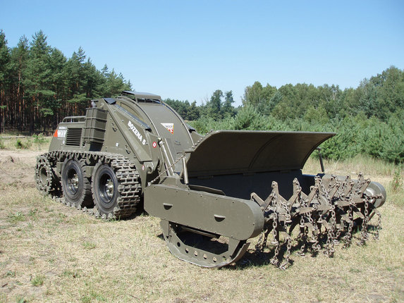
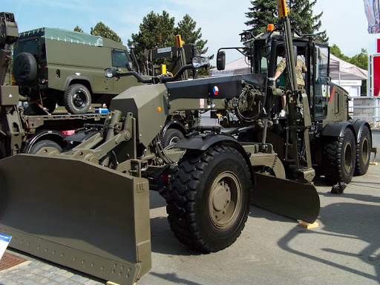
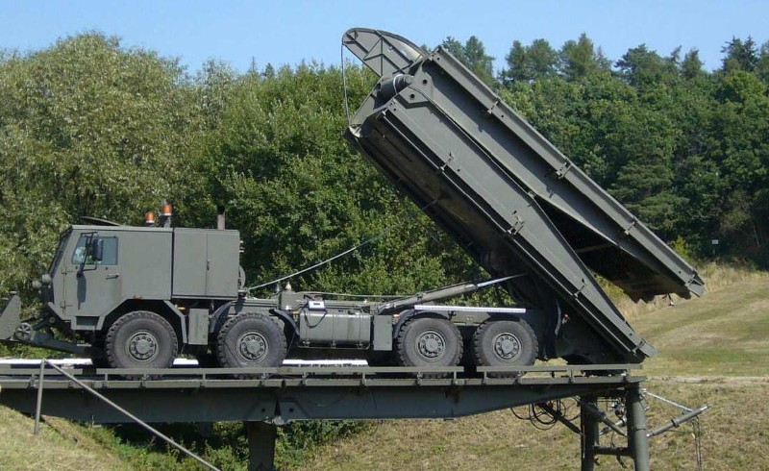
MILITARY ENGINEERING
SECURITY AND DEFENCE PROGRAMM
Czech Army Engineer Equipment

Slide 2
THE LESSON CONTENT PLAN
Questions answering (if any);
Assignment of individual work;
Independent work of students;
Partial conclusions Formulation
Notice:
You may have questions any time during the lesson.

Slide 3
ANY QUESTIONS?

