Slide 1
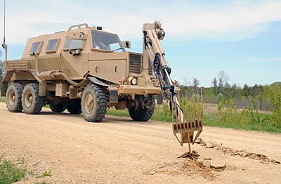
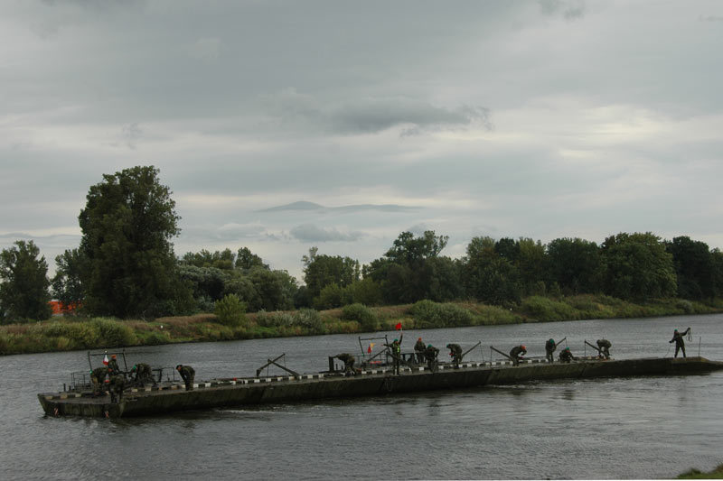
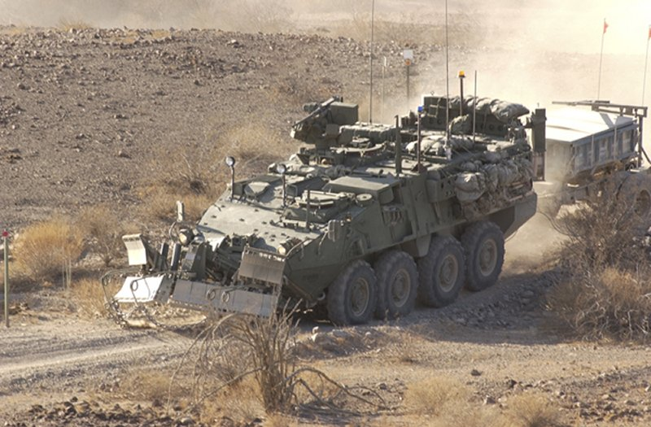
MILITARY ENGINEERING
SECURITY AND DEFENCE PROGRAMM
Mobility Support Tasks and Fundamentals

Slide 2
BASIC LITERATURE
STANAG 2528 ALLIED JOINT DOCTRINE FOR FORCE PROTECTION - AJP-3.14 (April 2015);
STANAG 2394 ALLIED TACTICAL DOCTRINE FOR MILITARY ENGINEERING – ATP-3.12.1 (February 2016);
STANAG 3680 NATO GLOSSARY OF TERMS AND DEFINITIONS (ENGLISH AND FRENCH) - AAP-6 (2012);
STANAG 2991 NATO COMBAT ENGINEER GLOSSARY – AAP-19(D); (August 2004);
AAP-15 NATO GLOSSARY OF ABBREVIATIONS USED IN NATO DOCUMENTS AND PUBLICATIONS (2010).

Slide 3
THE LESSON CONTENT PLAN
Explanation of mobility support principles and philosophy;
Characteristics of mobility support tasks
Questions answering (if any);
Notice:
You may have questions any time during the lesson.

Slide 4
THE CONCEPT OF MOBILITY SUPPORT
All arms/branches will attempt to bypass or overcome obstacles and maintain mobility by use of their own integral resources and efforts. In manoeuvre warfare when obstacles are encountered, the following actions will be attempted in the order shown so as to retain tempo and initiative:
Bypass
Overcome the obstacles using integral support
Deploy specialist obstacle crossing resources

Slide 5
THE CONCEPT OF MOBILITY SUPPORT
The maintenance of tempo and mobility in the face of an effective obstacle, whether laid by the adversant or not, will depend on the following:
An early assessment of the likelihood of obstacles to be crossed.
Deployment of the force in an appropriate manner, in order to overcome likely obstacles speedily as they are encountered.
Early detection and reconnaissance of obstacles.
Effective drills and procedures.

Slide 6
MOBILITY SUPPORT MAIN TASKS
Gap Crossing
Countermine Operations
Counter Obstacle Operations
Routes
Support to Forward Aviation.
Explosive threat Management
Route Clearance
Area Clearance
Military Search

Slide 7
MOBILITY SUPPORT TO OFFENSIVE OPERATIONS
Engineers will be required to support attacking forces by any or all of the following actions:
Breaching, marking or opening our own, as well as adversant minefields.
Providing the means of crossing rivers or other obstacles.
Securing the flanks by means of minefields, demolitions and other obstacles. These also help to shape and structure the battlefield and may allow commanders to use economy of force measures for force protection.
Preparing and maintaining routes for follow-up echelons.
Supporting the consolidation on the objective by digging, laying minefields and creating obstacles.
Route Clearance

Slide 8
MOBILITY SUPPORT TO OFFENSIVE OPERATIONS ENGINEER SUPPORT TO MOVEMENT
Engineer tasks in support of movement
Engineer reconnaissance
Establishment of by-passes
Clearance of obstacles and explosive threats
Building of bridges
Damage Repair
Road Upgrades

Slide 9
MOBILITY SUPPORT TO OFFENSIVE OPERATIONS ENGINEER SUPPORT TO MOVING FORMATIONS
Engineers may be required to pre-deploy some engineers into the theatre of operations in order to:
Clear EO and non-explosive obstacles.
Deal with scatterable mines.
Fill craters and repair route damage.
Bridge gaps.

Slide 10
MOBILITY SUPPORT TO OFFENSIVE OPERATIONS CROSSING AND BREACHING OBSTACLES
Crossing Operations. Crossing operations may be carried out in three overlapping phases:
Assault, to gain a lodgement on the far side of the obstacle. This phase is not required for an unopposed crossing.
Build-up, to extend the lodgement into a bridgehead.
Consolidation, to establish a firm base within the bridgehead from which to break out and continue the overall operation.

Slide 11
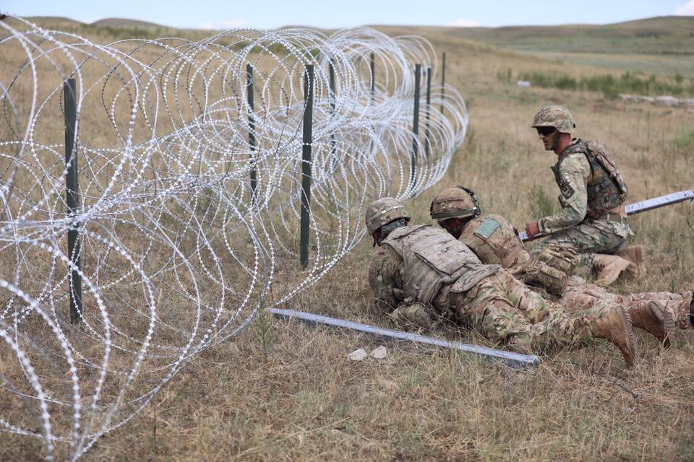
MOBILITY SUPPORT TO OFFENSIVE OPERATIONS CROSSING AND BREACHING OBSTACLES
Forces employed in a crossing operation may be organized as follows:
Bridgehead Force
Break-out Force
Force in Place

Slide 12
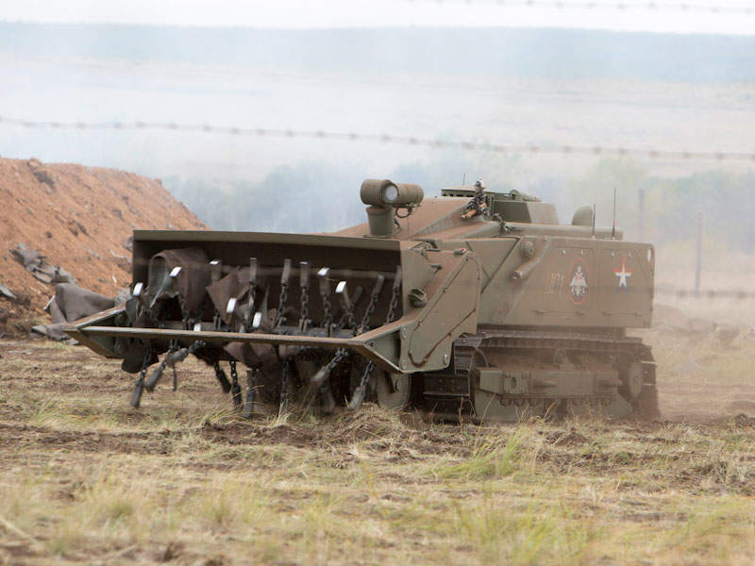
MOBILITY SUPPORT TO OFFENSIVE OPERATIONS MINEFIELD BREACHING
Reconnaissance
Locating Minefields
Minefield Composition
Breaching
Hasty Breach
Deliberate Breach

Slide 13
MOBILITY SUPPORT TO OFFENSIVE OPERATIONS Opposed Water Crossing Procedures
Deliberate Crossings
Movement Control
Planning and control of movement across water obstacles is the responsibility of the tactical commander of the crossing operation.
The movement control organization will be responsible for ensuring a coordinated and effective movement to and from the crossing sites.
Unit Commanders will be responsible for the movement of their own forces subject to the instructions of the movement control organization and crossing site commanders.
Engineer Advice
Communications
Other Support

Slide 14
MOBILITY SUPPORT TO OFFENSIVE OPERATIONS ROADS FOR TACTICAL MOVEMENT
Route Reconnaissance. Reconnaissance is required to determine the availability and trafficability of routes. Existing route networks must be checked and limitations or shortfalls identified. The reconnaissance must then determine what additional routes must be provided, taking account of the resources available.
Routes for Combat Vehicles. Routes primarily for use by combat vehicles are normally designed and constructed to carry limited traffic for relatively short periods. Requirements for construction will vary based on local conditions.
Routes for Logistic and Other Wheeled Traffic. Routes for wheeled traffic in the forward areas are usually built to support a moderate volume of traffic. The construction effort is likely to be more extensive than for tracked combat vehicles but similar techniques will be used; maintenance teams will be required. Routes can be subsequently upgraded if they are to be used more extensively.

Slide 15
MOBILITY SUPPORT TO OFFENSIVE OPERATIONS Support to Forward Aviation
Construction of helicopter landing sites (HLS); FOBs and FARPs.
Construction of landing strips, including the adapting of roads and other hard surfaces for use by aircraft.
Maintenance and repair of existing airfields, landing strips and other facilities.
Preparation of drop zones.

Slide 16
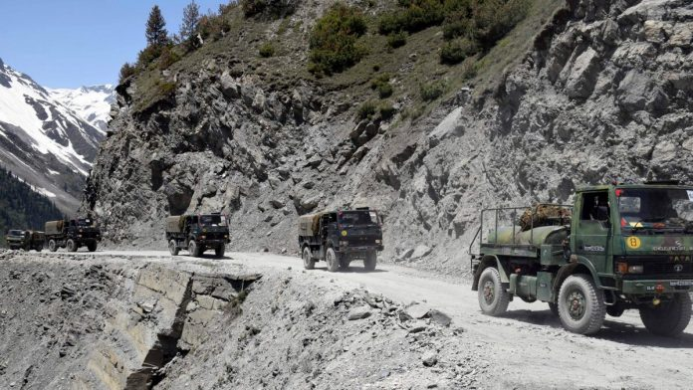
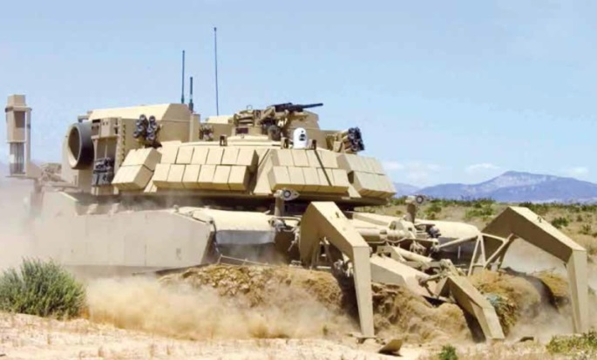
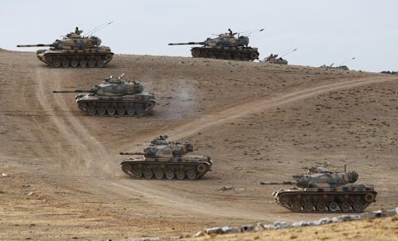
MOBILITY SUPPORT TO DEFENSIVE OPERATIONS
Routes.
Minefield Gaps and Lanes
Support to Counter Moves

Slide 17
ANY QUESTIONS?

