Slide 1
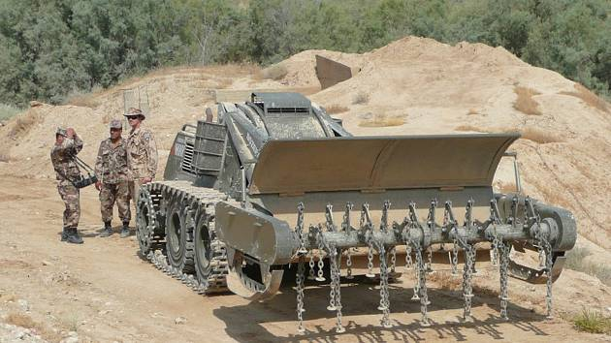
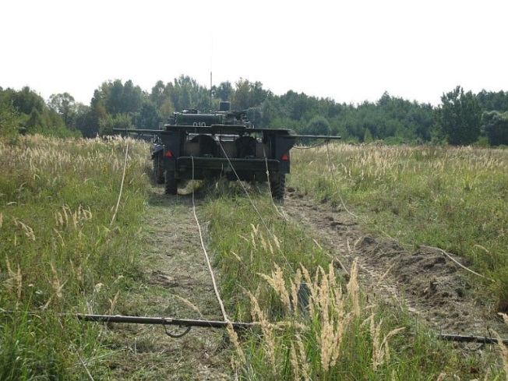
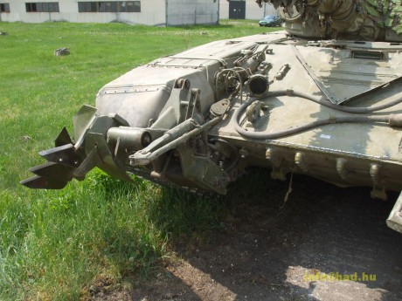
MILITARY ENGINEERING
SECURITY AND DEFENCE PROGRAMM
Demining Equipment

Slide 2
THE LESSON CONTENT PLAN
Explanation of demining equipment aim;
Characteristics of demining equipment
Questions answering (if any);
Notice:
You may have questions any time during the lesson.

Slide 3
Demining equipment
Demining equipment is the sum of facilities, equipment, devices and kits of material intended for exploration explosive roadblocks, creating passages in minefields and to complete demining field.
Demining equipment is divided into:
• Explosive,
• mechanical,
• manual demining.

Slide 4
Demining equipment
Explosive mine equipment used to activate or destruction min pressure wave caused by an explosion or detonation transmission and thus create a passage in a minefield.
Explosive mine clearance are:
• explosive demining,
• line charge.
Explosive demining VO is used to expand rail passes in the minefields for the tanks established mechanical demining.
Explosive demining VO:
• determination,
• specification (main TTD),
• main parts and their functions
• methods of demining.

Slide 5
Demining equipment
Mechanical demining KMT-6 is designed to establish rail passes in the minefields. Mines before the tank straps dig the ground and cleans the outside of the belt skew a shin. In setting up the passages in the minefields laid in the snow and frozen ground in the working system strengthens winter demining equipment.
Mechanical mine clearance forms a passage track width 620 mm, with an internal space demining 2070 mm. Mines with a stir inflator is fed to an explosion in the entire width of the tank.
Mechanical demining KMT-6:
• determination,
• specification (main TTD),
• main parts and their functions
• methods of demining.

Slide 6
Demining equipment
Mine clearing system/complete BOŽENA 5 is remotely controlled self-propelled armored demining machine that is equipped with a rotary flail demining equipment.
In light terrain is working an average speed of 4900 m², in the medium terrain 2400 m² and the difficult terrain of 1 050 m² per hour.
Mechanical demining BOŽENA 1 BOŽENA 5 is designed for surface mine clearance. Mines are activated before demining or disrupted by striking mechanism.
Mine set BOŽENA is suitable for large-scale demining mined areas. In addition to demining machine can be used to dispose of shrubs and low vegetation, after replacing the working tool then also for the transport and handling of hazardous materials or as a remotely controlled earth-moving machine. Its working speed depends on the terrain.

Slide 7
Demining equipment
Mine set BOŽENA 1 Universal Remote Control armored loader fitted with demining equipment. The ACR is used as a special engineer demining means.
Specifications BOŽENA 1
Parameters
length 5282 mm cleared path width 2000 mm
width 2716 mm clearance depth do 250 mm
high 2100 mm clearance area coverage 1800 m2/h
weight 11 720 kg range do 5 km

Slide 8
Demining equipment
Mine clearing system/complete BOŽENA 5 is remotely controlled self-propelled armored demining machine that is equipped with a rotary flail demining equipment.
In light terrain is working an average speed of 4900 m², in the medium terrain 2400 m² and the difficult terrain of 1 050 m² per hour.
Specifications BOŽENA 5
length 7320 mm weight with attachment 11 720 kg
width 3350 mm clearing width 2655 mm
height 2225 mm range to 2000 m
speed 4-9 km/h

Slide 9
ANY QUESTIONS?

