Slide 1
Military Leadership
Authority, Leadership and Power

Slide 2
Today’s program
What is authority?
How does authority differ from power?
in-group/out-group dynamics
The Milgram Experiment
The Stanford Prison Experiment
The Asch Paradigm of social influence
Self-identification
Authority as a means to direct in-group dynamics

Slide 3
in-group/out-group dynamics

Slide 4
The big question for social animals: how do you differentiate between in- and out-group members?
We define ourselves (at least in part) by defining who we are not
Security in the in-group, whereas the out-group is dangerous

Slide 5
The Milgram experiment: Authority

Slide 6
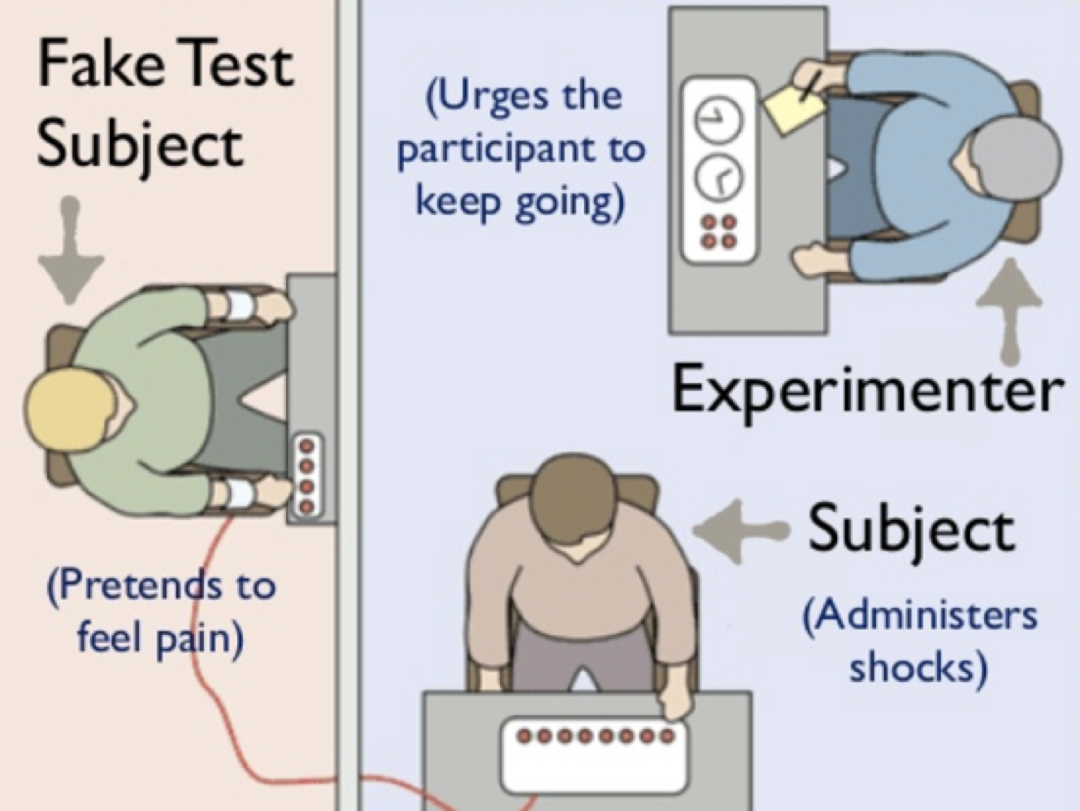
The Milgram experiment: Authority

Slide 7
The Milgram experiment: Authority
Expectation: only 0-3 % of participants will inflict lethal shocks on the “learner”
Reality: 65% of participants were willing to continue to a lethal 450 volts if told to do so by a man in a white lab coat.
These results have been replicated many times and each run led to similar results.

Slide 8
Implications
Authority, can under the right circumstances modulate our critical faculties and behaviour against our better nature.
However, the reverse is equally true, and there are many examples in which authority has kept people from acting out their resentment and frustration in morally reprehensible ways.

Slide 9
Stanford prison experiment

Slide 10
Stanford prison experiment II
24 subjects, randomly assigned to be
Prisoners
Prison guards
The experiment was terminated after only 6 days because the guards gradually moved from light harassment to severe maltreatment of prisoners and, what can only be described as, psychological torture.

