Slide 1
Crime with Environmental Impacts
Environmental Security

Slide 2
Introduction (1/2)
until 1989, there was no general standard in the Czech Republic regulating the issue of environmental protection
the long-term absence of environmental education has caused the company's low legal awareness to protect the environment
the environment is increasingly attacked by humans  destruction of air, water, soil, animals and flora
some interventions are so intense that it is possible to classify them as criminal offenses  environmental crime, ecological or environmental crime
Global environmental crime is the fourth largest sector of organized crime, with an estimated total of up to $ 260 billion per year  after drug smuggling, counterfeiting and human trafficking
economic performance in terms of growth rate surpasses the global economy by up to three times a year
the Czech Republic plays an important role as a transport hub as well as it has other domestic problems

Slide 3
Introduction (2/2)
unlike other known types of crime, it is worse due to additional costs, environmental impact and costs for future generations
deforestation, landfilling of chemicals and illegal fishing cause losses in the function of the ecosystem (lack of clean air and clean water, mitigation of extreme weather or food security)
it deprives governments of the necessary revenue and undermines legal business
endangers wildlife populations, but also damages at the ecosystem level through massive deforestation, pollution caused by unregulated chemical use and the destruction and destruction of livelihoods
illegal trade ranges from bush-meat poaching to the use of natural resources by transnational organized criminals and non-state armed groups with possible links to terrorism

Slide 4
Basic terms (1/3)
The environment is everything that creates the natural conditions for the existence of organisms, including humans, and is a prerequisite for their further development. Its components are mainly air, water, rocks, soil, organisms, ecosystems and energy.
An ecosystem is a functional system of living and non-living components of the environment, which are interconnected by the exchange of substances, the flow of energy and the transmission of information, and which interact and evolve in a certain space and time.
Ecological stability is the ability of an ecosystem to compensate for changes caused by external factors and to preserve its natural properties and functions.
Tolerable load on the territory is such a load on the territory by human activity, which does not damage the environment, especially its components, the functions of ecosystems or ecological stability.
Sustainable development of society is development that preserves the ability of current and future generations to meet their basic needs, while not reducing the diversity of nature and preserving the natural functions of ecosystems.

Slide 5
Basic terms (2/3)
Natural resources are those parts of living or inanimate nature that man uses or can use to satisfy his needs.
Renewable natural resources have the ability to be partially or completely regenerated during gradual consumption, either on their own or with the contribution of humans. Non-renewable natural resources are wasted by consumption.
Environmental pollution is the introduction of such physical, chemical or biological agents into the environment as a result of human activity that are, by their nature or quantity, foreign to the environment.
Damage to the environment is the deterioration of its condition by pollution or other human activity beyond the limits set by special regulations.
Environmental protection includes activities that prevent, reduce or eliminate pollution or damage to the environment. It includes the protection of its individual components, species of organisms or specific ecosystems and their interrelationships, as well as the protection of the environment as a whole.

Slide 6
Basic terms (3/3)
Ecological damage is the loss or weakening of the natural functions of ecosystems, resulting from damage to their components or disruption of internal links and processes as a result of human activity.
Wildlife crime is illegal poaching, smuggling or transport of a specific animal product or species (e.g. rhino horns or elephant tusks) carried out by a criminal group or individuals for financial or other material gain. This is the fourth most lucrative category of organized crime. Laws in this area are generally less strict than for other types of crime, so participation is less risky and more lucrative than other crimes.
Pangolins (Pholidota) are an insectivorous order of mammals with a body covered with large scales. We can find them in Africa and Asia. They feed mainly on ants, termites and other insects.

Slide 7
Institutions
Ministry of the Environment
Ministry of Agriculture
Ministry of Health
Ministry of Industry
…

Slide 8
International conventions
Convention on International Trade in Endangered Species of Wild Fauna and Flora
also called the Washington Convention
the purpose is to regulate international trade in endangered species of animals and plants ⇨ effective protection of certain species against extinction in nature (extensive capture or collection for international trade)
trade regulation is carried out by a system of export and import permits (so-called CITES permits), which are issued by the competent executive authorities of the member states ⇨ necessary when CITES specimens cross national borders
if the trade threatens the species for survival, permits are not issued to the applicant
applies to living organisms, but also any parts or products thereof (products from furs, skins and bones of protected animals, statuettes and carvings from rare woods or ivory, products of traditional Asian medicine containing extracts from protected animals or plants, gourmet specialties, etc.)
living and dead organisms are officially referred to as "specimens" in CITES
at present, 182 member countries have CITES
the Czech Republic has been a member country since 1 January 1993

Slide 9
CITES
protects more than 25,000 species of plants and 5,000 species of animals listed in the Annexes according to the degree of threat
CITES I - species directly endangered by extinction or extinction, ban on trade (e.g. Giant panda, some rhinos, elephants, Peregrine falcon, Salmon-crested cockatoo, Cuban Amazon, some species of orchids and cacti…)
CITES II - species that could be threatened with extinction or extinction if international trade in them were not strictly regulated (e.g. Black stork, Guanaco, Giant anteater, snowdrops…)
CITES III - includes species endangered only in the territory of a particular state that has requested the regulation of trade in them (e.g. Rose-ringed parakeet from Ghana, walrus from Canada…)
The European Union classifies species in CITES Appendices I-III to Appendices A, B, C and D
the annexes also include some other wildlife and wild plants occurring naturally in the EU
commercial use of Annex A (CITES I) species banned in the EU
defined as buying, offering to buy, acquiring for commercial purposes, public display for commercial purposes, use for commercial gain and sale, holding for sale, offering for sale or carrying for sale. Sale means any form of sale as well as rental, exchange or exchange.
the import of some species into the EU is prohibited (e.g. the turtle Trachemys skripta elegans)

Slide 10
Crimes against the environment
Damage and threat to the environment
Water source damage
Forest damage
Illegal discharge of pollutants
Illegal waste management
Illegal production and other handling of ozone - depleting substances
Illegal handling of protected wildlife and wild plants
Damage to protected parts of nature
Animal cruelty
Animal husbandry in inappropriate conditions
Neglect of caring for an animal due to negligence
Poaching
Illegal production, possession and other handling of medicinal products and other substances affecting the performance of livestock
Spread of contagious animal disease
Spread of infectious diseases and pests of useful plants

Slide 11
Global environmental crime
The Rise of Environmental Crime - A Growing Threat To Natural Resources Peace, Development And Security (UN and INTERPOL document from 2016)
the value of wildlife trafficking is in fact negligible compared to major environmental crimes
wildlife trafficking is estimated at $ 7-23 billion per year
Environmental crime is estimated at approximately $ 91-258 billion (2016) per year, a 26% increase over the previous estimate (2014)
environmental crime is growing by 5-7% every year, which is 2-3 times the rate of the global economy
Government revenue losses Tax revenues due to criminal exploitation amount to at least $ 9-26 billion per year
forest damage, including corporate crime and illegal logging, is estimated at $ 51-152 billion
illegal fishing is estimated at $ 11-24 billion
illegal mining is estimated at $ 12-48 billion
illegal waste management to $ 10-12 billion
natural resources have become another source of income similar to drugs, counterfeit, oil and antiques, funded by groups such as the Taliban, Al Qaeda and the Islamic State

Slide 12
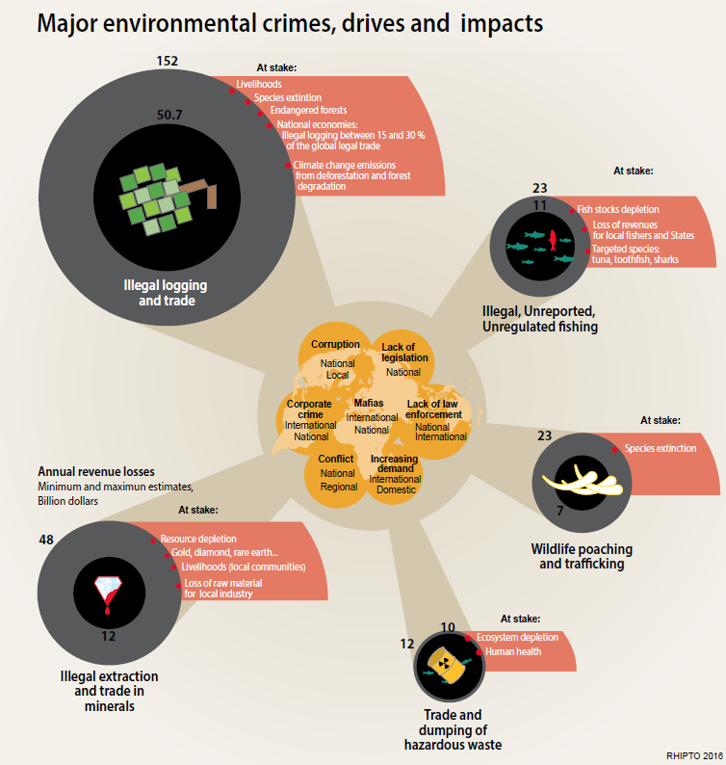
Source: https://reliefweb.int/sites/reliefweb.int/files/resources/environmental_crimes.pdf

Slide 13
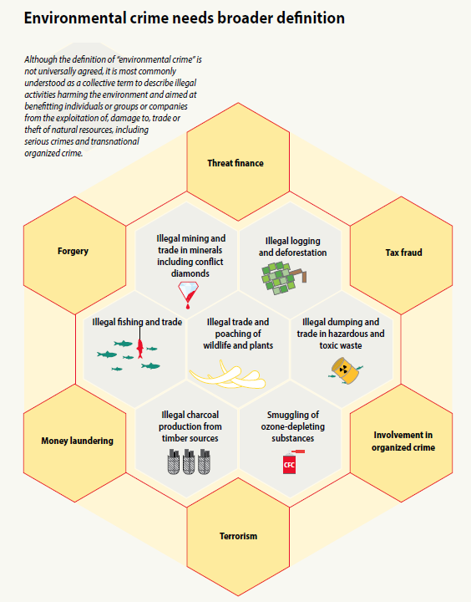
Source: https://reliefweb.int/sites/reliefweb.int/files/resources/environmental_crimes.pdf

Slide 14
Damage and threat to the environment
intentionally or through negligence
damage or threat to soil, water, air or other components of the environment, to a greater extent or in a larger area,
it can cause serious injury or death or if significant costs have to be incurred to deal with the consequences

Slide 15
Water source damage
damage to the water source for which the protection zone is established, so that the reason for the special protection of the water source is eliminated or significantly weakened

Slide 16
Forest damage
especially by unauthorized logging, in the form of clear-cutting or thinning of vegetation
production and non-production functions are reduced
usual practices of offenders:
interested in selling / buying forest and subsequent
extraction;
the interested party will buy the forest and in the near future
reports damage to an unknown perpetrator
theft of forest stand
damage to the surrounding forest during logging activities
notches (jams in standing trees)

Slide 17
Illegal waste management
illegal shipments of waste
waste management
car wreck management
illegal warehouses with dangerous substances

Slide 18
Illegal waste management
The Basel Convention on the Control of Transboundary Movements of Hazardous Wastes and Their Disposal (Basel Convention)
restricts the transboundary movement of hazardous waste and its disposal
Rotterdam Convention on the Prior Informed Consent Procedure for Certain Hazardous Chemicals and Pesticides in International Trade
the aim is to protect the environment and human health from the adverse effects of hazardous chemicals
Stockholm Convention on Persistent Organic Pollutants
the aim is to eliminate selected persistent organic pollutants

Slide 19
Poaching
game hunting (predator shots, nesting, laying, illegal beast shooting, game poaching), fishing, collecting bird nests,…

Slide 20
Illegal handling of protected animals
medicine
food
souvenirs and decorations
trophies
leather and fur
captive breeding

Slide 21
Elephants (1/2)
ivory - production of decorative items and ornaments (luxury carvings, statuettes, jewelry, chopsticks, wedding bracelets, buttons, marquetry…)
in Europe, billiard balls, combs and handles for cutlery, church monstrances, etc. were made of ivory, in America piano keys were made
to this day, there is a great demand for Christian ivory icons (especially in the Philippines) and the production of "hanko" stamps that replace personal signatures in Japan
the characteristics of the ivory of the three species of elephants differ slightly - a distinction is made mainly between soft ivory from savannah African elephants and hard from forest elephants (most valued by Asian carvers and traders), the Indian elephant is very rare
tusks cannot be cut from living elephants (as with rhino horns)  due to tusks the elephant must be killed  every ivory object comes from a dead elephant
poachers can be disclosed by circling vultures  they are killed with poisoned elephant carcasses (one can kill up to hundreds of vultures)  disruption of the ecosystem (vultures can digest carcasses infected with cholera, anthrax, etc.)

Slide 22
Elephants (2/2)
in some parts of Africa, ivory money is used to fund dictatorial regimes and insurgent units  ivory trade is also linked to regional security and threatens local people
ivory replaces "bloody" diamonds and is a bargaining commodity for rebels who exchange it for corrupt weapons with corrupt armed forces  advantageous article also for terrorist groups  does not require long-term control of the region such as oil or precious metals
ivory trade are financed by:
The Lord's Resistance Army (Congo, Central African Republic, Sudan)
Al Shabaab (Kenya, Somalia) - up to 40% of ivory income
Boko Haram (Nigeria)
Janjaweed (Chad, Central African Republic)
at least $ 12 million a year goes to these groups from the ivory trade
if the ivory trade is tolerated, it allows the financing of terrorist groups  the EU has included 'wildlife crime' in the EU Action Plan to step up the fight against terrorist financing

Slide 23
Rhinos (1/3)
the first written mention of the healing effects of the rhino horn is in the so-called First Herbarium of Traditional Chinese Medicine from 200 BC  the horn is intended to reduce fever, detoxify and fight bleeding
in the Middle Ages, decorative cups were made from the corners to detect poison in a poured drink
handles of traditional daggers "jambia" in Yemen  a sign of wealth and invincibility of the owner, fathers give the sons of jambia as a symbol of maturity  the price of a dagger with a rhino horn is around 7,000 euros
the horn is also used for religious purposes – in China, Vietnam, India and Turkey it is used to make rosaries and religious bracelets

Slide 24
Rhinos (2/3)
the illegal horn trade used to go mainly to Yemen, Korea, China, Taiwan and Japan
by 2008 the situation was quite stable, but then there was a significant breakthrough  in Vietnam there was a rumor that the rhino horn cures cancer and also serves as a prevention against this disease
there was a huge increase in demand and a sharp expansion of illegal trade  the price of horns soared to about 60,000 USD / kg, which is 2.5 times more than the price of gold (in 1975 it cost 1 kg of a corner of 35 USD)
the main consumer country today is Vietnam, followed by China
demand for corners is completely unsatisfactory and poaching is still escalating (an increase of 2,000% compared to 2008) - today an average of 3 rhinos are killed per day
however, up to 90% of rhino horns on the market in Vietnam are counterfeit – from the horns of cows, buffaloes, to resin or plastic, which indicates a significant demand

Slide 25
Rhinos (3/3)
in 2010 in Europe a series of burglaries in museums and castles  aimed to taxidermies with rhino horns
organized by the Irish criminal syndicate Rathkeale Rovers (stolen horns sold to Asia)
a total of 67 thefts and 15 attempts occurred in Europe
criminal groups visited 16 European countries and stole 94 rhino horns worth a total of about CZK 0.5 billion
there were 7 thefts in the Czech Republic and also the biggest theft in Europe - 7 horns were stolen from the Úsov chateau, which would have a price of 1,100,000 euros on the black market
some groups were arrested – 19 members of Rathkeale Rovers were arrested in Britain in 2013 and sentenced to a total of 71 years in prison (the value of the horns stolen by this group was 70 million euros)
in the Czech Republic, the perpetrators of thefts in Napajedla and Buchlov were caught and sentenced to 5 years in prison
museums and castles were warned to replace the real horns on the exhibits with replicas
in 2013, Europol warned that zoos could be attacked
inspectors warned the management of Dvůr Králové Zoo because this zoo breeds the largest number of rhinos in Europe
in 2017, unknown perpetrators broke into a rhino enclosure in the Thoira Zoo 50 km from Paris, killed a 5-year-old male rhino with three blows to the head and cut off his horn with a saw

Slide 26
Tigers (1/3)
people's interest has led tigers nearly to the extinction
demand for furs, trophies and products made from tiger bodies
around 1900 there were over 100,000 tigers in the wild, the current population is about 3,800 individuals, of which only about 40% reproduce
some tiger subspecies have already been completely extinct (eg Bali tiger, Caspian tiger, Javan tiger)

Slide 27
Tigers (2/3)
the largest consumers of tigers are China and Vietnam
the tiger trade has been internationally banned since 1990
due to high demand, there is a large-scale illegal trade in which organized criminal gangs are also involved
most tigers live in India, where the most poachers also  smuggling routes lead from India through the mountains of Nepal and Tibet to China, tigers caught in the Indochina area are sent to traffickers in Vietnam
the Czech Republic is also heavily involved in the tiger trade  the reason is the presence of a strong Vietnamese community with a great demand for tiger products
in 2013, customs officers in the Svitavy region stopped the car of a Vietnamese citizen and found a complete tiger skeleton hidden in bags of clothes inside
in the same year, two tiger skeletons exported from Prague to Hanoi were confiscated at the airport in Ruzyně
in recent years, tiger canines, claws and bones have been repeatedly found in the luggage of Vietnamese citizens traveling from Prague to Hanoi
there are also liquid broths and solid bone broth made by long boiling tiger bodies

Slide 28
Tigers (3/3)
since 2007 about 360 tigers have been bred in captivity in the Czech Republic (only 39 in the zoo)
due to a growing problem, the Czech Environmental Inspection performed comprehensive inspections of all tigers bred  many tigers disappeared, died or were exported to quite suspicious facilities
the average life expectancy of a tiger in private breeding in the Czech Republic is 5 years, while in nature or in the zoo it lives up to 20 years
owners of tiger farms demand legalization of trade in tiger products  restoration of the status of a tiger as a "consumer" animal and the impossibility of control or differentiation of legal and illegal goods

Slide 29
Pangolins (1/3)
pangolin is the only mammal that has scales on its body
pangolins are today the most traded animals in the world
every day, more than 100 kg of scales or bodies travel illegally across borders in Asia  populations in nature are declining, but the demand for pangolins is still rising
For comparison - annually the nature is captivated by:
200 tigers
1,000 rhinos
100,000 pangolins
according to statistics, more than 1,000,000 pangolins were caught in the wild in 2004-2013
scales are crushed into a powder that is used in Chinese, Korean and African traditional medicine
although there is no research to confirm their therapeutic effect, people believe that scales cure skin and venereal diseases, promote blood circulation and lactation, treat swelling, asthma, abscesses, rheumatism, arthritis, and relieve menstrual pain
legal trade in pangolin scales is allowed in China, but since 2007 the scales may only be used with a certificate of origin and in specially designated hospitals in the form of patented products  legal consumption in China averages 26,600 kg of scales per year (documented in 2008-2015)

Slide 30
Pangolins (2/3)
the animals are caught and killed in huge numbers, the killed pangolins are boiled with hot water and the scales are peeled off
most of the detected smuggled consignments contain dead frozen bodies without scales - the scales are traded and sent separately  the price of scales in wholesale ranges between 500-600 USD / kg, in retail 800-1200 USD / kg
scales are also used to make souvenirs (scales with engravings and pictures), jewelry (necklaces and pendants) or talismans against witches and demons
in some African countries, people believe that when a woman burns a pangolin scale in front of a man's door, he falls in love with her
scales are also burned in the fields to repel wild animals or as a ceremony to summon rain
in Tibet and Nepal, pangolin scales are the material for the production of ritual Tibetan "nagi" incense sticks used in the Ribo Sangcheo or Lugta purification ceremony (also imported into Europe)
pangolin skin is used on leather products (e.g. in the US special cowboy boots)
pangolin are also hunted for meat  in Africa it belongs to the species hunted and consumed within the so-called bushmeat
in Asia, the demand for pangolins is growing  they are considered a delicacy  since the 16th century, pangolin meat has been consumed in China as a tonic
currently it is a luxury food  pangolins are served roasted, in sauce, stewed, and even unborn individuals are processed – Chinese special soup in which the pangolin embryo floats

Slide 31
Pangolins (3/3)
international survey in 2010-2015 reveals new routes of illegal trade ⇨ most of the trade takes place in Asia (China, Vietnam, Malaysia and Hong Kong) ⇨ the source is countries where pangolins occur in the wild and where they are illegally poached – in Africa especially Cameroon , Nigeria, Uganda and Sierra Leone, in Asia Indonesia, Malaysia and Myanmar
in Asian ports, huge consignments containing several tones of dead pangolins, scales or even live animals are often confiscated
pangolins are transported alive and are killed only after transport to the destination (the meat does not spoil)
animals are heavily parasitized, doped with strong antibiotics and vitamins to withstand transport
pangolins are forcibly fed a large volume of gypsum powder or Dioscorea root powder to increase their sales weight
the vast majority of animals, if discovered and confiscated, will die in a very short time ⇨ the chance of returning to nature is practically zero
from Africa, pangolins are often sent to Asia in transit through Europe (France, Belgium, Germany, the Netherlands and Switzerland)
the Netherlands and Switzerland are considered to be the target countries for pangolins consumption, as is the US – for example, in 2015, a consignment of 700 kg of ivory and 2,000 kg of pangolin scales destined for the Netherlands was seized in Uganda
pangolins can be helped by a combination of several approaches – strict protection in nature, strict control and punishment of perpetrators (poachers, traffickers and consumers) and spreading awareness, especially in Asia

Slide 32
Primates (1/2)
60% of primate species are threatened with extinction and numbers are declining in 75% of species
primates are particularly threatened by the loss of their natural environment  ​​transformation into plantations or ranches
road construction, the extraction of raw materials or environmental pollution also contribute to the threat to primates
primates are often hunted for meat or for illegal trade
hunting is a major cause of declining populations of large primates in Africa and Southeast Asia
the cause of hunting is usually the trade in their meat (bushmeat), to a lesser extent the trade in live young or various parts of the bodies of apes, which are later used for ceremonial or medical purposes
occasionally hunting is the result of human-primate conflict (crop damage)
in some countries (especially in Africa) hunting and sale takes place mainly for cultural or religious reasons, in many countries (e.g. Latin America, South and Southeast Asia) it takes place on a much more massive and economically motivated scale (demand for traditional medicine, domestic pets, trophies, luxury cosmetics or the entertainment industry

Slide 33
Primates (2/2)
Eastern Europe – in some former Soviet states private collections of oligarchs
Bonobo chimpanzees smuggled through Armenia and sent to Russia and neighboring republics, including Ukraine, a problem in the Middle East (chimpanzees, orangutans)
for the sale of a small chimpanzee or gorilla, poachers have to kill an average of 10 adults (poachers often injure even the spotted cub)
in the case of orangutans, it is "enough" to kill the mother, it is not necessary to get rid of the whole group
China imports hundreds of illegally obtained chimpanzees from the wild regulace circumvention of regulation
in West Africa, chimpanzees have been declared highly endangered in countries such as Côte d'Ivoire, 90% of the chimpanzee population has been lost in the last 15 years

Slide 34
European Union Network for the Implementation and Enforcement of Environmental Law (IMPEL)
international non - profit association
an informal network of European regulators and institutions
focus on the implementation and enforcement of environmental law
registered in Belgium, established in Brussels
55 members from 36 countries, including all EU countries, Northern Macedonia, Serbia, Turkey, Iceland, Kosovo, Albania, Switzerland and Norway
www.impel.eu

Slide 35
TigrisID
in 2019, the TigrisID project focused on the development of identification kits for tiger DNA was introduced, supported by the Security Research program for the needs of the state 2016-2021 Ministry of the Interior of the Czech Republic
in addition to identification kits, we are working on a system for exchanging forensic data and a related database ⇨ with the aim of preparing an effective tool for proving trade in products from protected species
as part of the preparation of a resolution on Asian large felines, the Czech Republic proposed to the parties to the CITES Convention to send samples from live tigers to the Czech Republic, including confiscated specimens or products with suspected tiger DNA content
new modern forensic approaches enabling a more effective fight against the illegal trade in tigers and their products ⇨ such as the method of detecting DNA in heavily processed products, such as tiger broths and broths captured in the Czech Republic during Operation Trophy (2018), the possibility of assigning DNA to individual specimens or the development of a database on the hereditary information of individual tigers
Czech zoos are involved in the project, which provided samples of their farmed animals, European zoos, the European Association of Zoos and Aquariums also cooperates

