Slide 1
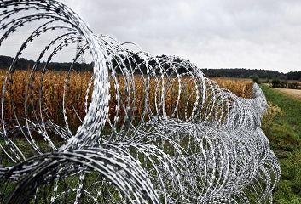
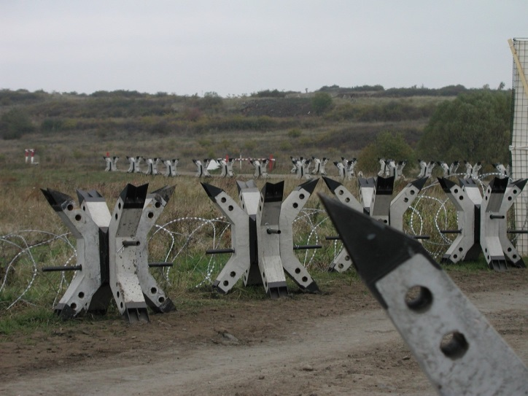
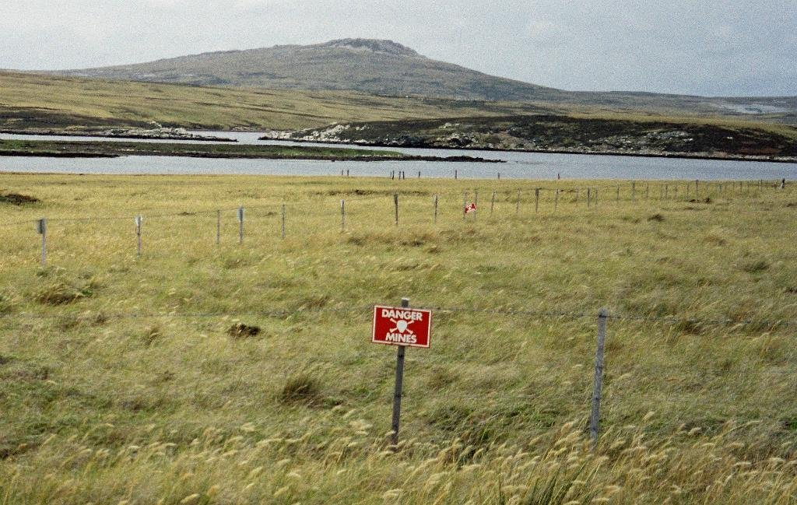
MILITARY ENGINEERING
SECURITY AND DEFENCE PROGRAMM
Countermobility Tasks and Fundamentals

Slide 2
BASIC LITERATURE
STANAG 2528 ALLIED JOINT DOCTRINE FOR FORCE PROTECTION - AJP-3.14 (April 2015);
STANAG 2394 ALLIED TACTICAL DOCTRINE FOR MILITARY ENGINEERING – ATP-3.12.1 (February 2016);
STANAG 3680 NATO GLOSSARY OF TERMS AND DEFINITIONS (ENGLISH AND FRENCH) - AAP-6 (2012);
STANAG 2991 NATO COMBAT ENGINEER GLOSSARY – AAP-19(D); (August 2004);
AAP-15 NATO GLOSSARY OF ABBREVIATIONS USED IN NATO DOCUMENTS AND PUBLICATIONS (2010).

Slide 3
THE LESSON CONTENT PLAN
Explanation of countermobility principles and philosophy;
Characteristics of countermobility tasks
Questions answering (if any);
Notice:
You may have questions any time during the lesson.

Slide 4
THE CONCEPT OF COUNTERMOBILITY
Counter-mobility operations must be correctly balanced so as to disrupt the adversant’s mobility while limiting the restriction on our own ability to manoeuvre freely. Barriers may be terrain, target or situation oriented. The increasing likelihood of operating in the urban/close terrain environment has already been noted and the requirement for a coherent counter-mobility capability can be demonstrated here as well as in more open terrain, with the common intent of shaping adversant movement into areas of our choosing.
In order to achieve the precise effects on adversant manoeuvre that are required by the commander, obstacle planning will take place following Intelligence Preparation of the Battlefield (IPB) and the estimate process, in which the commander will express his intent in terms of Combined Arms Obstacle Integration (CAOI) and will seek to maintain his own freedom of manoeuvre whilst constraining that of his adversary by disrupting, turning, fixing or blocking.

Slide 5
COUNTERMOBILITY MAIN TASKS
Emplacing Obstacles. This includes a wide range of options such as the use of mines, explosives, digging etc, to achieve the desired effect depending on the situation.
Reinforcing Man Made Obstacles. The strengthening of civilian structures and military obstacles.
Enhancing Natural Obstacles. The enhancement of natural obstacles, to include gaps and trees.
Increasing Combined Arms/Branch Synchronization. The value of obstacles can be greatly increased by overlaying them with effective fires.

Slide 6
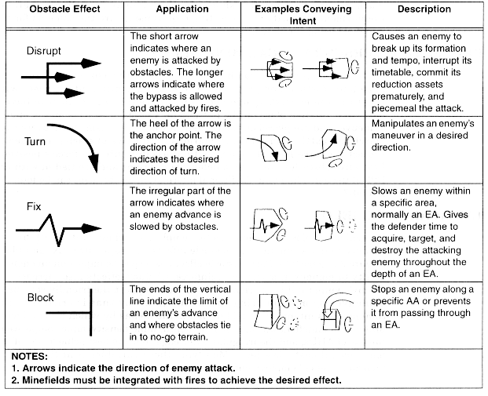
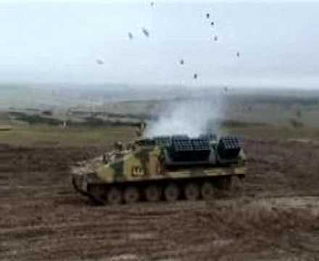
COUNTERMOBILITY IN OPERATIONS
Terrain, situation and target oriented barriers may be used in offensive operations. To limit the restriction on friendly force manoeuvre, control measures, such as Barrier Restricted Areas (BRA) may be imposed.
Tactical-obstacle effects

Slide 7
COUNTERMOBILITY IN OPERATIONS
In offensive operations, counter-mobility tasks may include:
Flank protection.
Consolidation on an objective with consequent adoption of a defensive posture.
Denying adversant withdrawal routes.

Slide 8
COUNTERMOBILITY IN OPERATIONS
Support to flank protection forces is likely to be the most important counter-mobility task for offensive operations with an open flank. Engineer tasks could include:
Route denial.
The planning and use of rapid scatterable mine systems
Preparing a range of other obstacles depending on time and the terrain

Slide 9
COUNTERMOBILITY IN OPERATIONS
Consolidation. Engineers must plan for and be ready to execute a rapid transition to defensive operations. When an objective has been taken, engineers may carry out counter- mobility tasks in order to support the attacking force against counter-attacks.
Care must be taken during consolidation that any counter-mobility activities undertaken do not impede our own freedom of manoeuvre, in relation to subsequent offensive operations.

Slide 10
ANY QUESTIONS?

