Slide 1
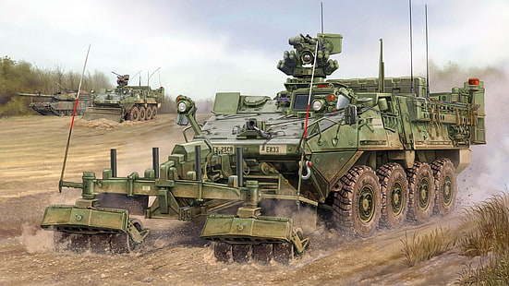
MILITARY ENGINEERING
SECURITY AND DEFENCE PROGRAMM
Engineer Support within Operations

Slide 2
THE LESSON CONTENT PLAN
Questions answering (if any);
Students' presentations;
Discussion;
Conclusion.

Slide 3
ANY QUESTIONS?

