Slide 1
Selected slides from the seminar for teachers
Speaking Skills for Academic Purposes
Emma Lay

Slide 2
Lectures & Presentations: functional language
Putting it in other words
In other words, ....
That is to say, ....
To put it another way, ....
The point I'm making is ....
What I'm suggesting is ....
Let me put it another way.
Giving examples
An example of this is ....
For instance, ....
And as proof of that, ....
Remember ....
You only have to think of ....
Referring back to what you have said
As I said at the beginning, ....
In the first part of my talk, I said ....
As I mentioned earlier, ....
I told you a few minutes ago that ....
Using visuals
On this graph, ...
Take a look at this.
Let's have a look at this.
I'd like you to look at this.
I'd like to draw your attention to ...
Here we can see ....
As you can see, ....
If you look closely, you'll see ....
Moving on
I'd like now to move on to ....
Turning now to ...
Moving on now to ....
Having looked at ..., I'd now like to consider ....
Now, let's turn to ....
I now want to turn to ....
The next point is ....
Another interesting point is ....
The next aspect I'd like to consider is ....
I'd now like to turn to ....
Concluding
So ....
We've seen that ....
First we looked at ... and we saw that ....
Then we considered...and I argued that...
So basically .....
we have looked at ....
To sum up ....
To finish up, I'd like to emphasise that..

Slide 3
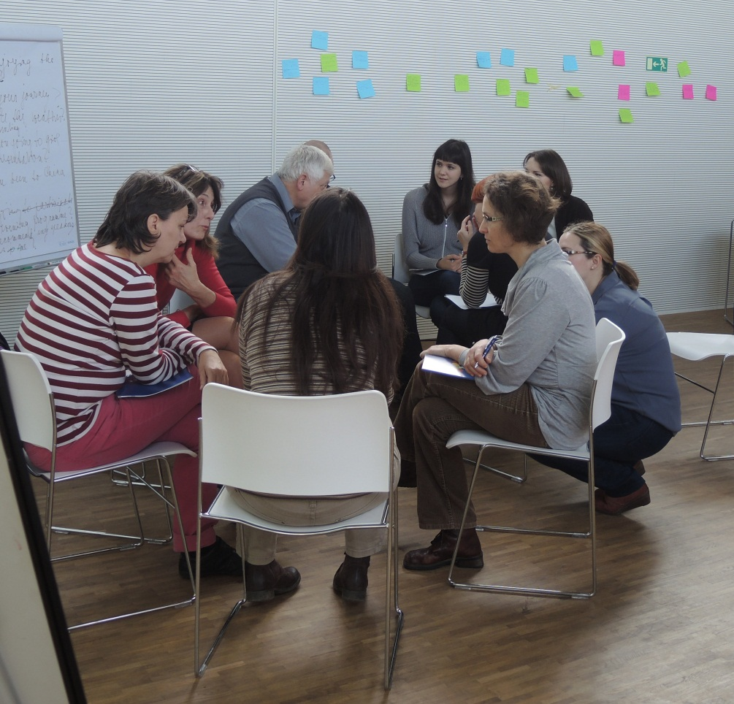
Seminars: management and participation strategies
Opening
So what I’d like to start with is...
So, who wants to get things going?
What I’d like us to discuss today is…
So, let’s get the ball rolling!
Interrupting to comment
If I could just come in here.
Sorry to butt in, but ....
Can I just add....
That’s a really interesting point but it’s worth remembering that…
That’s great but have you thought about…
Clarifying Questions
That's not really what I was asking. My question is about ...
Perhaps I didn't make my question clear. What I asked/meant was..
I think you've answered a slightly different question. What I would like to know is ...
I understand that but what I actually had in mind was ....
I think you’ve got the wrong end of the stick there, what I meant was…

Slide 4
Seminars: management and participation strategies
Encouraging participation
Does anyone have any comments or questions?
So is this the same as your experience?
Do you agree with what X has just said?
So, Y, what is your opinion of this?
Redirecting the discussion
... is important but it's too complex for us to deal with now.
I see where you’re going but really we need to keep to the topic.
I think the aim of this seminar is to focus on ... rather than ....
That's not something we have time to deal with today, but ....
Let’s come back to that [point] later.
Closing
So, let’s leave it there for today. That was a really [useful / interesting / productive] session.
So, let’s wrap up for today.
That’s all we’ve got time for today. There’s a lot to think about there.
Ok, let’s finish there. Some really interesting comments/contributions.
Lots of great ideas. Let’s pick this up next time.

