Slide 1
Writing IV
1. Repetitive jobs are boring – feedback
2. Comparison/contrast

Slide 2
SAMPLES I
They do the same many hours a day, usually for many years and it causes their occupation makes them disgusted.
Problems with repetitive process are usually stuck to people who spend their daily duty by assembly line.
As a result of a fact that a level of their education is not skilled enough, in conjunction with a poor relation between them and their field, is their frustration and inability to improve their qualification to apply more interesting position.
That the step number one for rising themselves and for fulfilling their living demands after they get a job of their dreams.
Some people are bored and gloomy in their employment because they have an appointment which they dislike and their feelings from his career are dispirited because the assignment is repetitive.

Slide 3
SAMPLES II
They do the same kind of activity for many hours per day routinely for many years; therefore they have lack of interest in their profession.
Problems with repetitive occupations usually have people who work in a factory …
Some people are dissatisfied and uninterested in their career because they don’t like it and their sensations are cheerless from his monotonous employment.
They do the activity for many hours per day usually for many years; therefore they are bored in their labour.
Often, these workers can’t choose other way because of their education. It is at poor level and these employees are not able to find an improved position
… they cannot change their deal due to the low qualification.

Slide 4
SAMPLES III
Generally installation where is everything all day repetitive and dull or labor is very uninterested for all population and everybody does it extremely unwillingly.
Some people are burn-out and despondent in their job because they have an occupation which they dislike and their feelings from his labor are miserable because the work is repetitive.
If people will to switch their being they have to take the chance and study …
Often, these workers stuck in a rut of what to do, their education is insuficient and these empoyees are not able to find more attractive career.
Than they can modify a chore and begin feeling well in the occupation and lifetime.

Slide 5
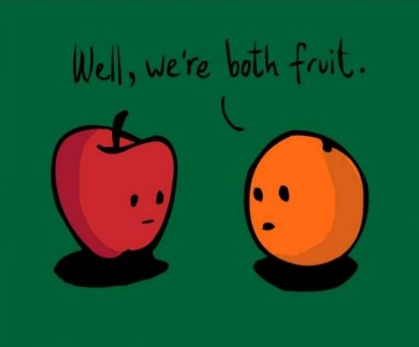
COMPARISON/CONTRAST
Read the text „Changes in Education for the 21st Century“
Which is the topic sentence?
Which sentence or sentences conclude the text?
Which are the transition signals to make the paragraph coherent?
Which model is used in the text?
Organizing the text: two basic models
MODEL A:
Point-by-point Organization
Topic sentence/thesis statement
Body – Argument A – similarity/difference
Argument B – similarity/differece
…
Conclusion
MODEL B:
Block Organization
Topic sentence/thesis statement
Body
A Similarities/presence/…
B Differences/past/….
Conclusion

Slide 6
Noticing vocabulary: Antonyms Which can you see in the text?
Match the word in column A with their antonyms in column B
A 1. wide B a) move
2. mostly b) boredom
3. required c) global
4. interested d) modern
5. local e) optional
6. remain f) seldom
7. traditional g) narrow
1G 2F 3E 4B 5C 6A 7D

Slide 7
With a partner, find two antonyms for each of the words:
Adaptable ………………………… ……………………………….
Continue ………………………… ……………………………….
Expand ………………………… ……………………………….
Major ………………………… ……………………………….
Real ………………………… ……………………………….
Long ………………………… ……………………………….

Slide 8
Comparison Signal Words
Human workers can detect malfunctions. Robots can detect malfunctions.
Similarly/likewise
Also
Too
As/just as
And
Both… and
Not only… but also
Neither …. nor
Like (+ noun)/just like (+ noun)/similar to (+ noun)
To be like/similar to/the same as
To be the same
To be alike/similar
To compare (to/with)

Slide 9
Contrast Signal Words
To point out unexpected result: People go on diets. Very few succeed in loosing weight.
However/nevertheless/nonetheless/still
Althought/eventhough/though
But/yet
Despite (+noun)/ in spite of (+noun)
To point out direct opposition: More white performers do rock music. More black performers do jazz.
However/in contrast/in (by) comparison/on the otherhand/on the contrary
While/whereas
But
Differ (from)
Compared (to/with)
To be different from/to be dissimilar to
To be unlike

Slide 10
Homework
Choose a topic and write a short text comparing/contrasting your ideas about the topic.
Beware of listing!
Support your arguments.
Suggested topics:
City life/country life
The cost of living in two places
Public transportation or a car
Spenders vs. Savers
Morning people vs. Night people
Eating home or eating out
….. 150-200 words

