Slide 1

Writing VIII
Developing a good writing style

Slide 2
How?
Collocations
Participles
Clauses, Complex sentences
Parallel structure
Sentence fragments
Punctuation

Slide 3
Collocations
Words that appear together in a specific patern e.g. do homework, a tall tree
NOT make homework, high tree
Read the text „In support of homeschooling“ and complete the following collotacions:
_____________________ number
_____________________ professionals
_____________________ use
learning _______________________
_____________________ animation
_____________________ museums
admissions _____________________
well-balanced __________________

Slide 4
Use the words from the box to form collocations with all the words in each list:
attention community percentage skills
individual/personal/undivided ________________
large/significant/surprising __________________
global/business/Italian-American ______________
social/basic/communication __________________
Use the following collocations to write a sentence about your own educational experiences:
Major challenge
Personal experience
Conscious effort
Once-in-a-lifetime opportunity
Effective use
Achieve my goals

Slide 5
Participles – an adjective formed from a verb
Present participle a sleeping baby
Past participle a frightened child
An active voice becomes an –ing participle
  The essay won an award. John wrote the winning essay.
A passive voice becomes an –ed participle
  My leg was broken in 3 places. My broken leg is healing slowly.
There are also perfect forms
  The students had solved most of the problems without any help.
  Having solved most of the problems without any help, the students were exhilarated.

Slide 6
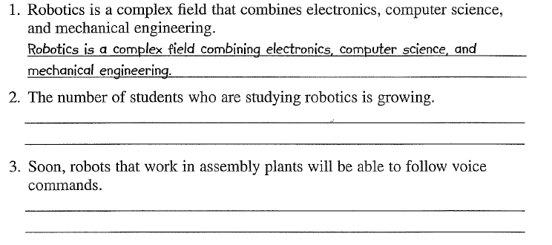
A pedestrian who had been hit by a speeding taxi was lying in the street.
  A pedestrian hit by a speeding taxi was lying in the street.
An ambulance that was called by a bystander came quickly.
  An ambulance called by a bystander came quickly.
The taxi driver, who did not realize what had happened, continued on.
  The taxi driver, not realizing what had happened, continued on.

Slide 7
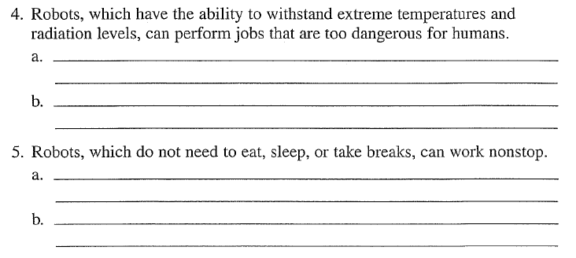

Slide 8
Clauses, complex sentences – connecting sentences together

Slide 22
Improve it!

Slide 23
Parallel structure – to add symmetry and style
Important especially when listing and comparing and contrasting items or ideas. Each item in the list or comparison follows the same grammatical pattern.

Slide 26
Sentence Fragments – incomplete sentences of parts of sentences
Because some students work part-time while taking a full load classes.
Where is the problem? How can we solve it?
Add an independent clause:
Because some students work part-time while taking a full load of coursses, they have very little free time.
Delete the subordinator (because):
Some students work part-time while taking a full load of classes.

Slide 29
Punctuation
1. Introducer commas:
Words: Nervously, I threw away my cigarettes.
Phrases: As a result, I feel terrible right now.
Dependent clauses: Because I have a chronic cough, my doctor recommended that I quit immediately.
Quotations: „Stop smoking today,“ she advised.
2. Coordinator commas – link equal elements in a sentence:
2 independent clauses: They were tired, so they went home early.
Series of words or phrases: He does not enjoy skiing, ice-skating, or sledding.
A nurse has to work at night, on weekends, and on holidays.

Slide 30
3. Inserter commas:
Words: My uncle, however, refuses to quit smoking.
Phrases: My father, on the other hand, has never smoked.
Phrases and clauses: My aunt, his wife, died of lung cancer.
My mother, who just celebrated her fiftieth birthday, enjoys an occasional cigarette.
Reporting verbs
in direct quotations: „I have tried to quit dozens of times,“ she says, „but I can´t.“
X
People who smoke 60 cigarettes a day risk lung cancer.
4. Tag commas:
Words: My uncle believes in drinking a daily glass of wine, too.
Phrases: He swims for an hour every day, for example.
Tag questions: It is not logical, is it?
Direct quotations: He laughs and he says, „I will outlive all of you.“

Slide 31


