Slide 1
Subversive threats Introduction to the course
Mgr. Dominika Kosárová, PhD.
Center for security and military-strategic studies, University of Defence
e-mail: dominika.kosarova@unob.cz

Slide 2
Who am I?
Education:
2010-2018: international relations (University of Matej Bel, Slovakia) – Ph.D.
2014-2015: geopolitics (Université de Reims, France) – double degree (M.A.)
Erasmus: Sheffield Hallam University (UK), Université de Lorraine (France), Science Po Grenoble (France)
Additional courses:
NATO Defence against Terrorism, NATO School Oberammergau, Germany
Program on Terrorism and Security Studies, GCMC, Germany
Seminar on Regional Security, GCMC, Germany
Program on Applied Security Studies, GCMC, Germany
Middle East Summer School, Ludwig Maximilian University, Germany
Senior Course on Crisis Management and Civil Emergency Planning, Swedish Defence University, Sweden
Confronting terrorism in today’s world, University College Roosevelt, Netherlands
From intervention to non-intervention: The triumph of sovereignty over human rights? Singidunum Uni, Serbia
Career:
since 2018: Center for security and military-strategic studies, University of Defence
internships: International Organization for Migration, Representation of the European Commission in Slovakia, AIESEC China

Slide 3
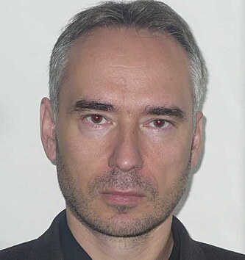
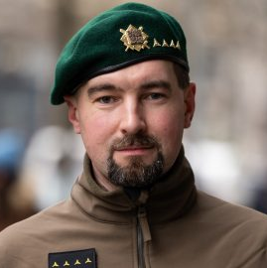
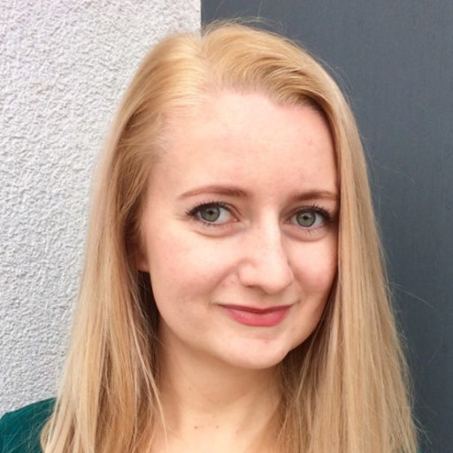
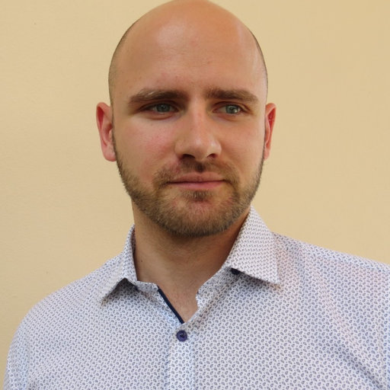
Our team
Dr. Dominika Kosárová
garant
Dr. Richard Stojar
Capt. Jakub Fučík
Dr. Miroslava Pačková
Dr. Adam Potočňák

Slide 4
Useful information
Moodle
Form: 9 lectures + 8 seminars + credit seminar (June 20)
In case of absence during the seminar, the student will be given individual homework
Evaluation:
final test + active participation in seminars
need to achieve at least 50% in each criterium
Contact:
Email: dominika.kosarova@unob.cz
Tel.: 973 442 744
Office: C115, 23 Tučkova Street
A | 90 – 100
B | 80 – 89
C | 70 – 79
D | 60 – 69
E | 50 – 59
F | 0 – 49

Slide 5
Name
Country of origin
Why did you choose this course?
What are your expectations from the course?
What are your hobbies?
Anything else...

